Slide 1
Postoperative O₂ Therapy in Patients with OSA: A Randomized Controlled Trial
Liao P et al. Chest 2017
To investigate the effect of supplemental O₂ on oxygen saturation, sleep respiratory effects and CO₂ levels in untreated OSA.
Screened: 722
Consented:195
Preoperative PSG: 170
obstructive sleep apnea pt: 123
Control: 61
Oxygen: 62

Slide 2
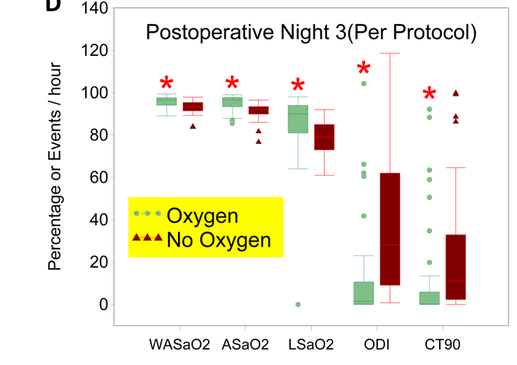
Changes in parameters measuring O2 saturation (posto night 3, per-protocol analysis) Liao P et al. Chest 2017
*: p<0.05 vs No-Oxygen
Notes:
WASaO2
ASaO2
LSAO2

Slide 3
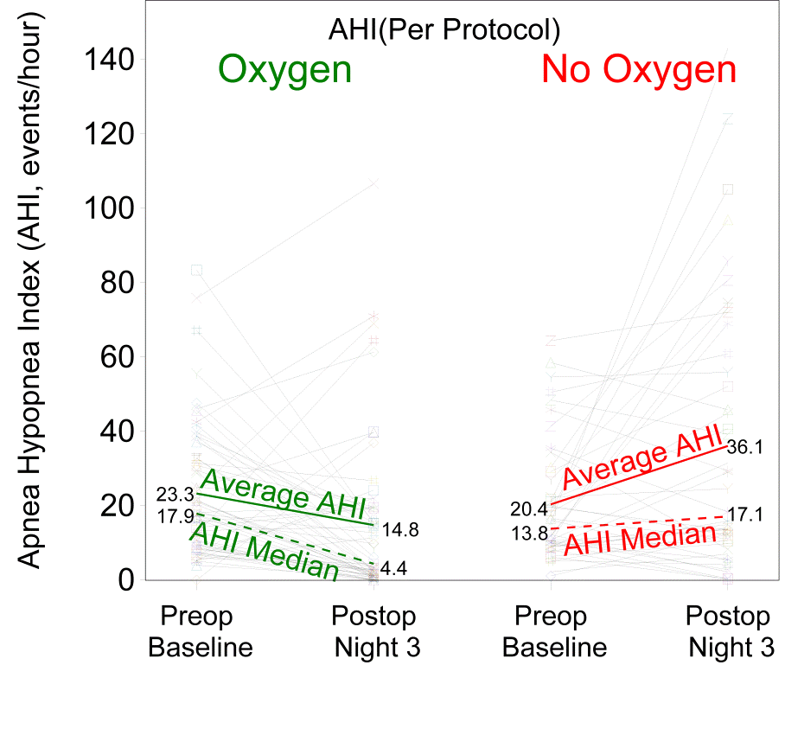
AHI change from preop to postop night-3 in two groups, per-protocol analysis Liao P et al. Chest 2017

Slide 4
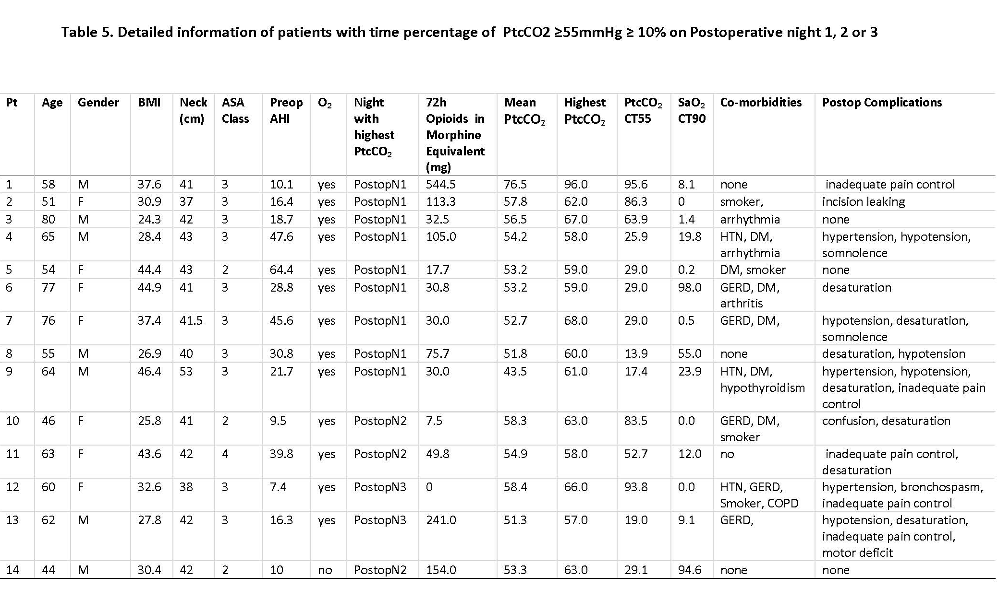
Postoperative O2 Therapy in Patients with OSA. Liao P et al. Chest 2017
14 Patients had high Ptc CO₂ postoperative nights
One pt. Ptc CO₂ 96 mmHg
7 pt. Ptc CO₂ >60 mmHg
14 patients had worrying high CO2
indicating respiratory depression

